Slide 1
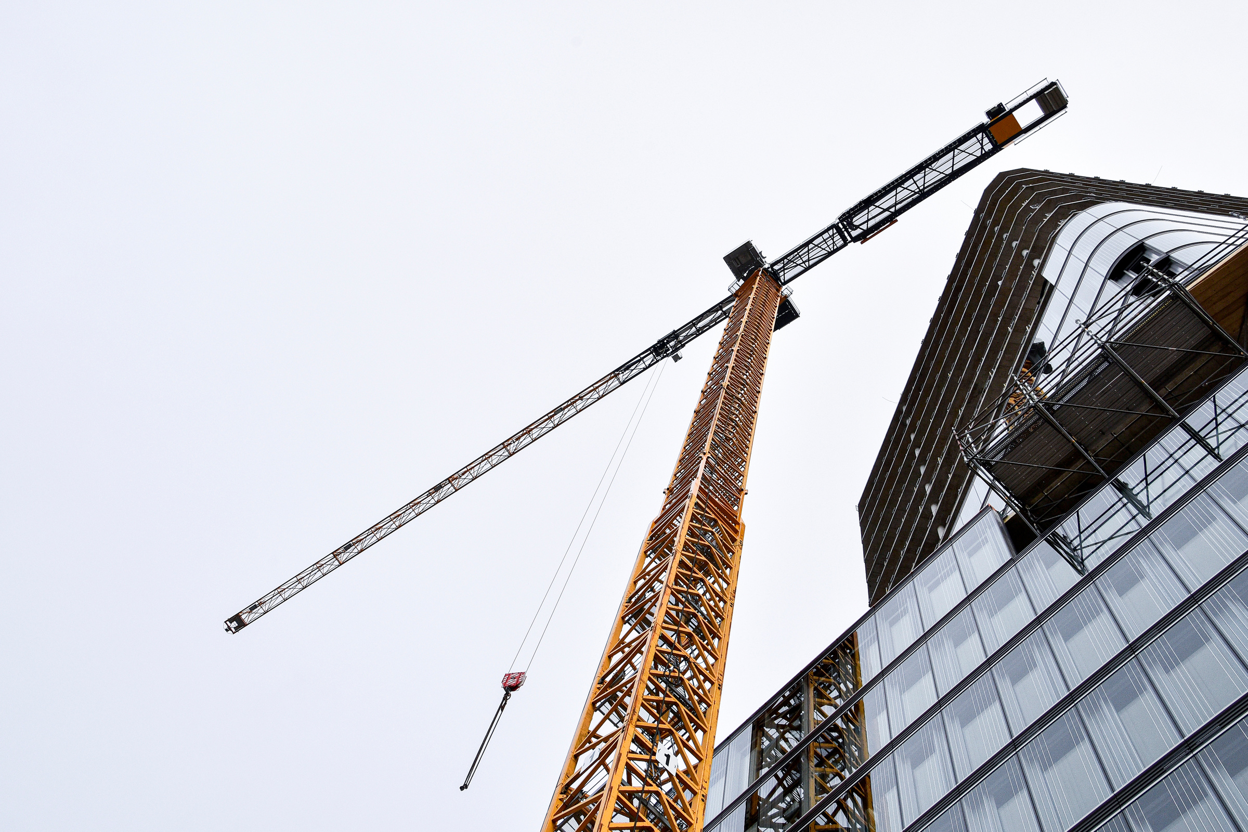
DYNAMIC ANALYSIS OF A CONSTRUCTION TOWER CRANE
ME313 Project Report & Safety Assessment

Slide 2
BACKGROUND AND PROJECT SIGNIFICANCE
The background emphasizes the importance of understanding dynamic behavior to ensure crane safety and longevity.
Importance of Cranes: Cranes are useful and frequently used equipment with wide, global application. The construction of large and tall structures is impossible without them.
Source of Dynamic Load: In most building construction, tower cranes are used to lift and move payloads. Payloads have a tendency to sway about the vertical position under excitations. This sway creates a pendulum motion, which leads to vibrations and an unwanted dynamic load on the crane body.
Consequences: This dynamic loading shortens the crane's lifetime. Factors like stress, strain, and fatigue can damage the structure and must be fully understood before a crane is designed.
Project Context: An in-depth understanding of the physical nature of the crane will assist the engineer in redesigning the structure and ensuring a safe and stable system.
Previous Limitations: Most analysis carried out on cranes to date only accounts for the simple pendulum motionof the payload, often ignoring cable flexibilities.
This Study's Approach: This project analyzed a 2-D crane while specifically taking into consideration the payload's pendulum motion, the cable flexibility, and a wide angle for pendulation.

Slide 3
CORE PROJECT OBJECTIVES
The study objectives are outlined below:
Physical Modelling : Develop a comprehensive but simplified physical model of a construction tower crane that captures the essential dynamics while remaining mathematically tractable.
2. Mathematical Formulation: Derive the non-simplified Pendulum Equation of motion based on the Lagrange Equation and Rayleigh’s dissipation function and solve it numerically based on the Runge-Kutta method.
3. Numerical Implementation: Through MATLAB-based numerical simulation, obtain a comprehensive understanding of:
Payload swing dynamics under realistic operational motion profiles
Natural oscillation characteristics and frequency response
Dynamic forces and rope tension variations
System stability and predictability
4. Modal analysis: Employ the “System Linked by Two Coordinates” methodology to compute the lowest four natural frequencies.
5. Finite Element Analysis: Creating the 2D soft model of tower crane and verification of the modal result on Ansys Workbench with mathematical model.
6. Study of operational safety margins and compliance with international standards

Slide 4
ASSUMPTIONS
The crane tower, jib, and attached machinery are modelled as rigid bodies with lumped masses and inertia parameters.
The payload and trolley are considered as point masses, with the rope mass neglected or partially distributed among point masses for dynamic calculations.
Element connections, such as ropes and joints, are considered massless but possess defined elastic stiffness and damping coefficients. The rope’s elasticity and damping are included where applicable.
Wind loads and foundation flexibility are neglected in the scope of this study.
The base of the crane is fixed for boundary conditions, mimicking real-world support constraints, and initial conditions of cable length and payload position are prescribed.
Numerical methods (e.g., Runge-Kutta, FEM) are employed to solve the nonlinear system of equations due to the complexity of the crane dynamics.

Slide 5
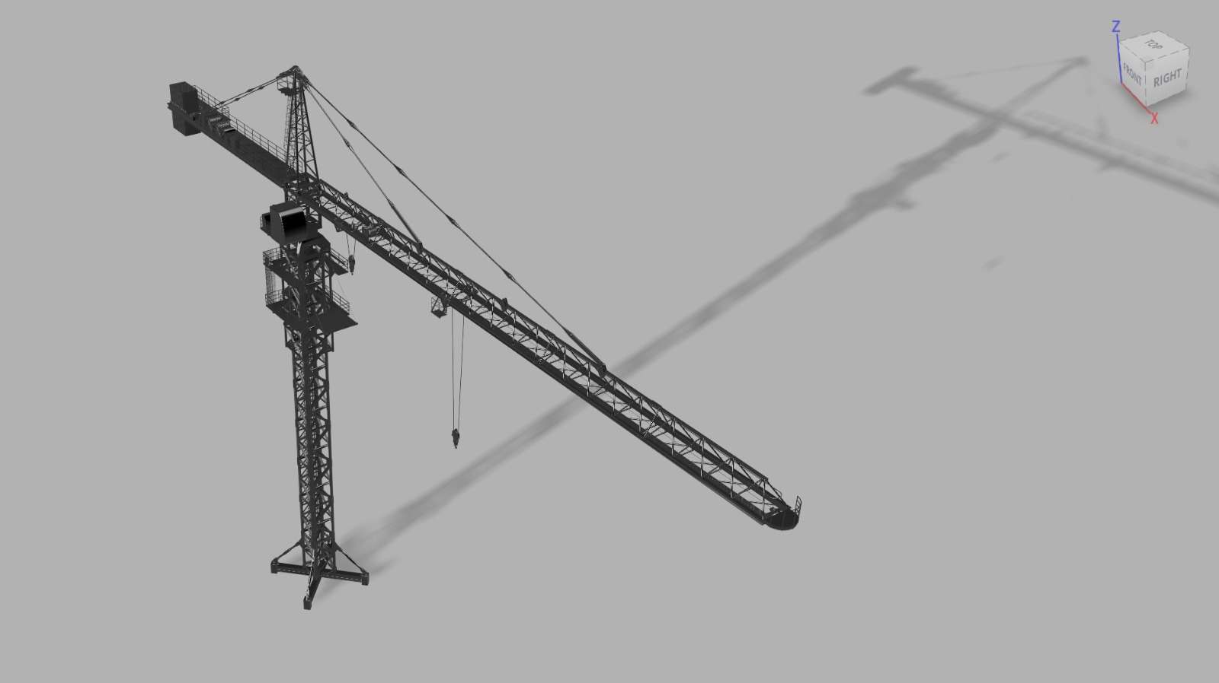
CAD Model

Slide 6
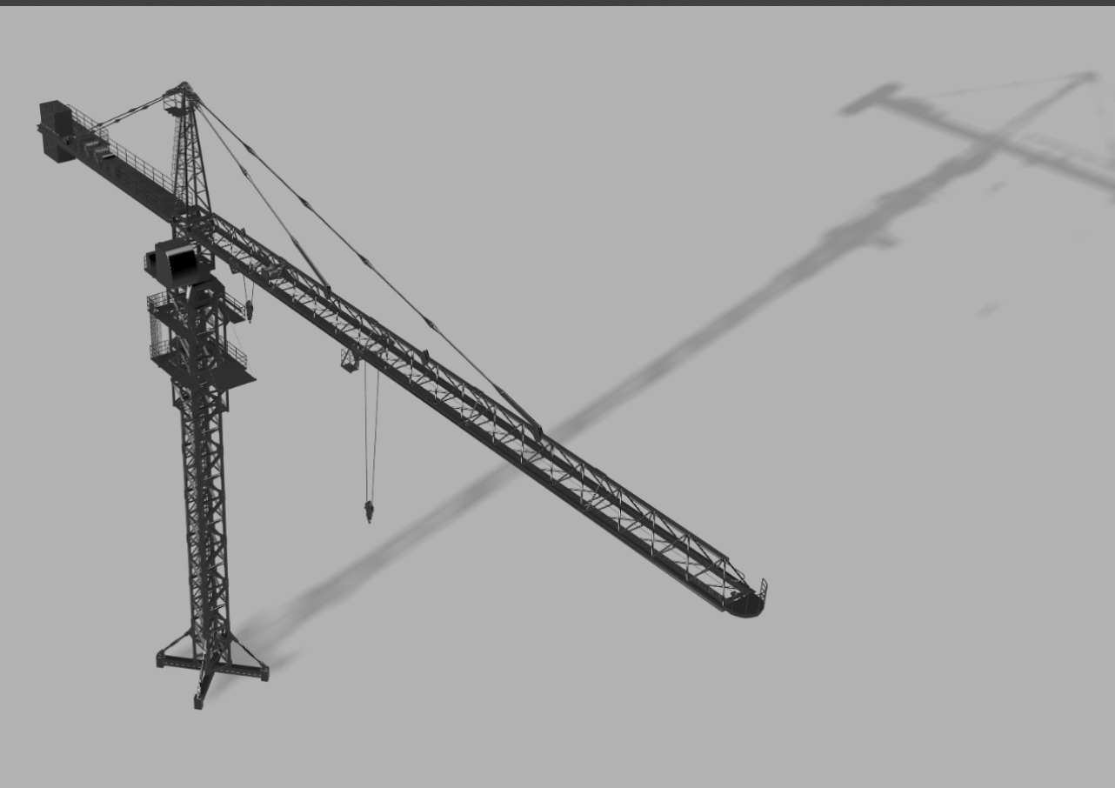
PHYSICAL MODEL
The study models a planar tower crane with a 30-meter tower, 40-meter jib, 500-kg trolley, and 1000-kg suspended payload connected by a 10-meter rope.
The tower crane system analysed in this project consists of five primary structural and functional components:
1. Tower (Vertical Mast Structure)
The tower provides the primary vertical support structure for the entire crane system. It must withstand the maximum combined loads. It is modelled as a rigid body with fixed boundary conditions.
2. Jib (Horizontal Boom Structure)
The jib provides horizontal reach for load positioning. The trolley travels along the jib to vary the load's horizontal distance from the tower centerline, thereby changing the system's moment arm and dynamics.
The jib is modeled as rigid, supported at one end (tower attachment point).

Slide 7
3. Trolley (Carriage System)
The trolley is the active element that moves horizontally to position the load. Its motion is prescribed (controlled input), making it the forcing function for the payload swing dynamics.
In the mathematical model, the trolley is treated as a moving point mass with prescribed motion history x(t). The trolley's actual acceleration profile is specified as a design input. This reflects typical crane operations where motion profiles are programmed into controller systems.
4. Rope/Cable (Load Suspension)
The rope suspends the payload and transmits vertical forces from load to trolley. It also serves as the constraint that couples trolley motion to payload dynamics. Here, the rope is assumed to be a massless, inextensible, single line element with a massless pulley.
5. Payload (Load Being Transported)
The payload is the object being transported. Its inertia and gravity create the dynamics that the trolley motion induces through the rope constraint.

Slide 8
component | value | unit
Tower height | 30 | m
Jib length | 40 | m
Rope length | 10 | m
Trolley mass | 500 | kg
Payload mass | 1000 | kg
Max trolley speed | 2.0 | m/s
Payload density | 100 | kg/m^3
Gravity | 9.81 | m/s^2
Air density | 1.2 | kg/m^3
SYSTEM PARAMETERS
A fixed inertial coordinate system is also established as:
Origin: Located at the initial trolley position (directly below tower apex)
Coordinate Axes:
· X-axis: Horizontal direction along the jib (positive in direction of initial trolley motion)
· Y-axis: Vertical direction (positive upward)
· Z-axis: Horizontal perpendicular to X (forms right-handed system; not used in 2D analysis)
Time Reference: t = 0 at start of trolley motion

Slide 9
Pendulum Motion Analysis

Slide 10

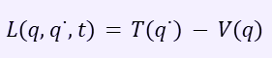
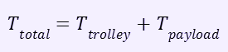
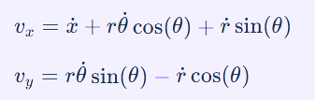
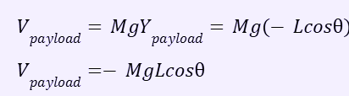
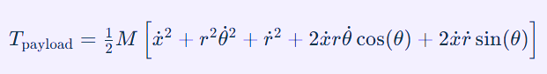
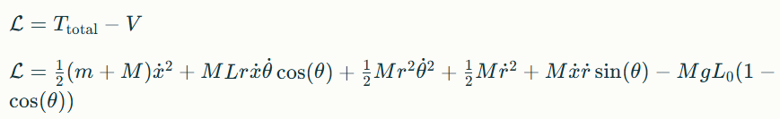
Mathematical Methodolgy
Lagrangian Function
Total Kinetic Energy
Payload Velocity
Gravitational Potential Energy
Payload Kinetic Energy
Lagrange Funtion

Slide 11
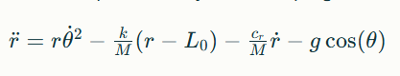
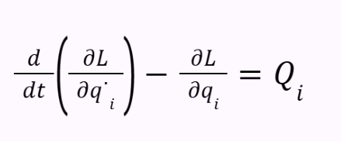
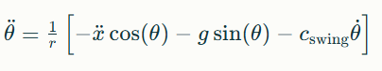
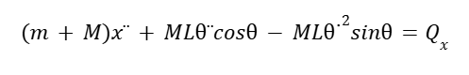
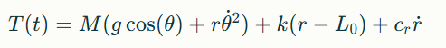
Mathematical Methodolgy
Rope Extention Equation
Euler-Lagrange Equation
Equation of motion for swing angle θ
Equation of motion for trolley coordinate x
Dynamic tension in cable

Slide 12
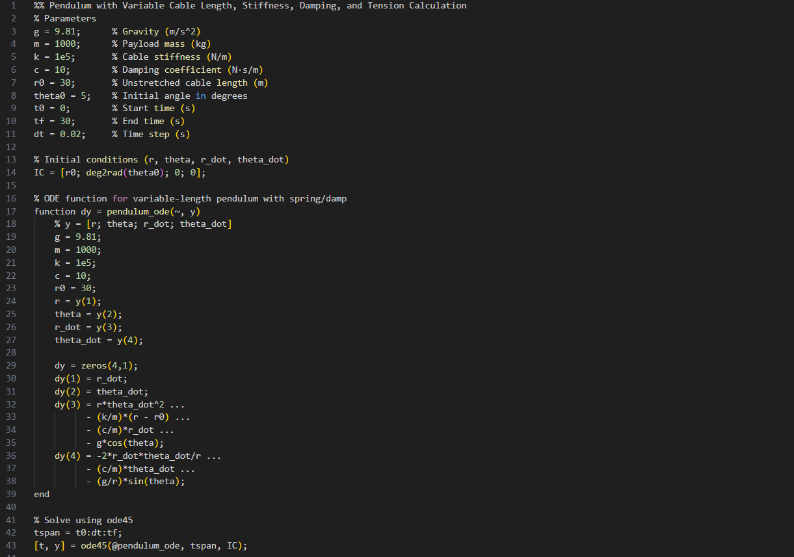
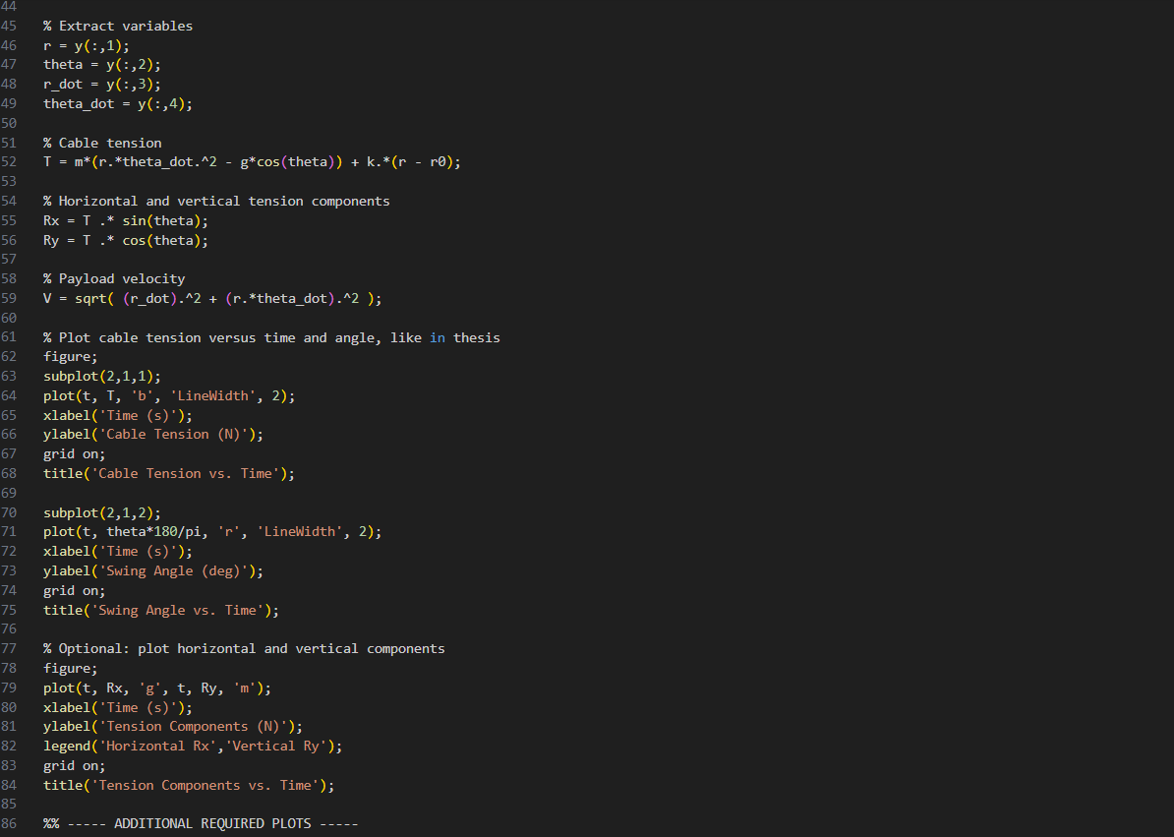
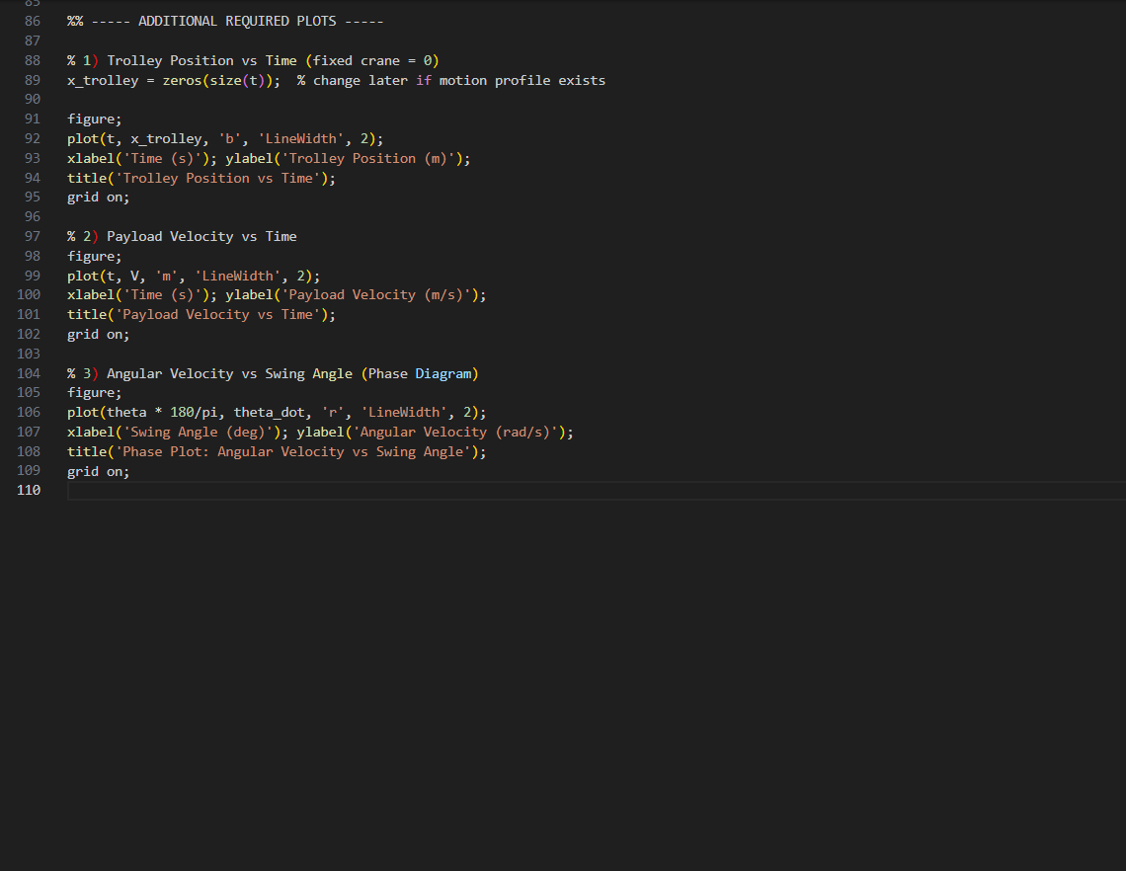
MATLAB Code Snippets

Slide 13
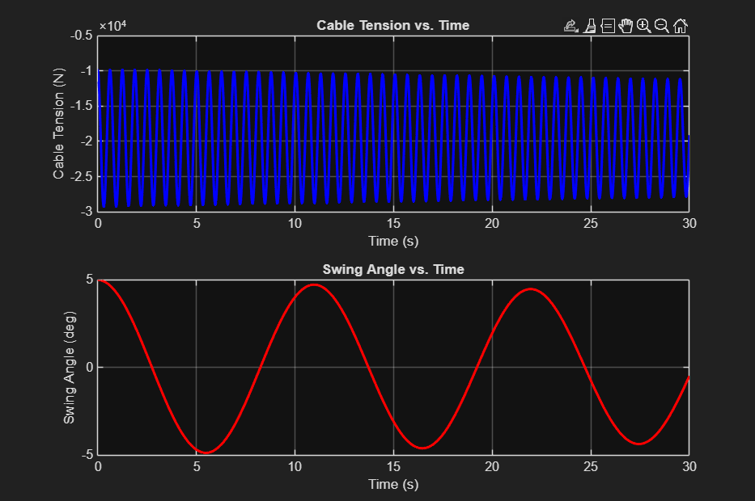
Numerical Results

Slide 14
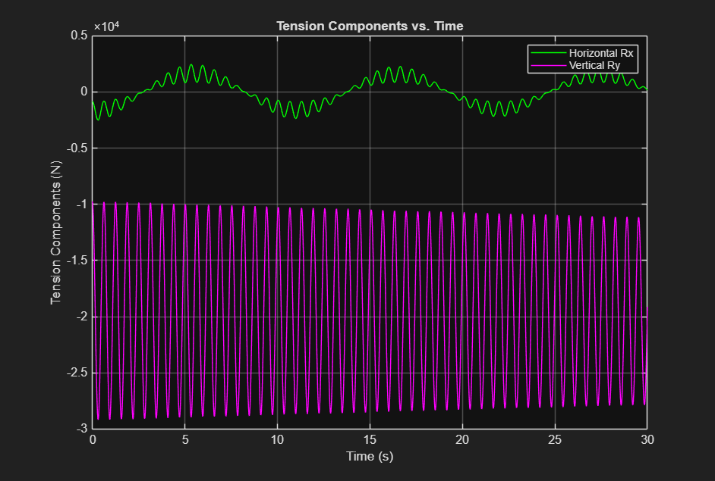

Slide 15
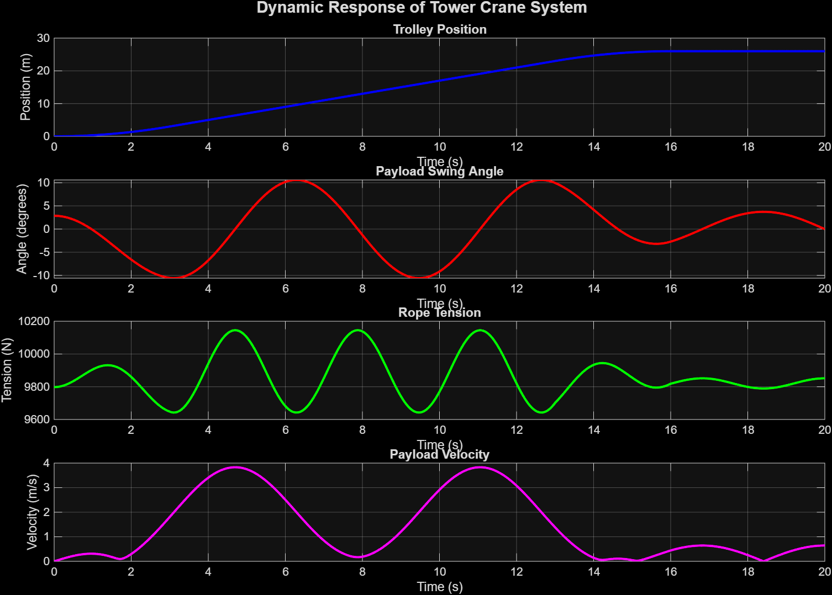
Trolley Position and Velocity

Slide 16
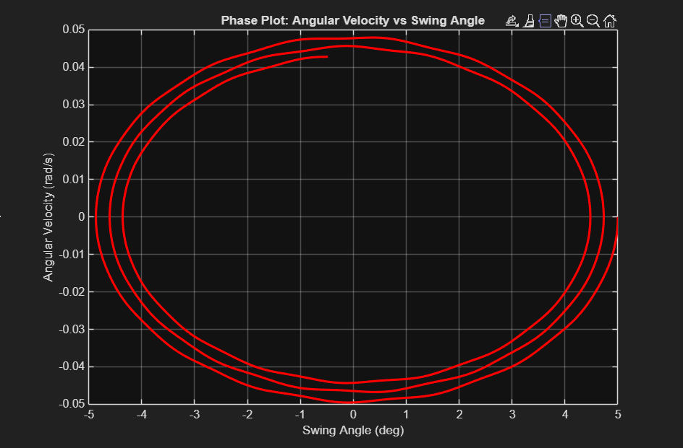

Slide 17
Modal Analysis

Slide 18
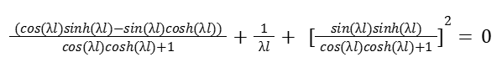
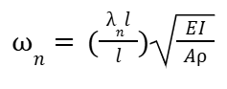
Mathematical Methodolgy
Characteristics Equation
For cantilever beam with combined bending and torsional effect
General Formula for Natural Frequencies

Slide 19
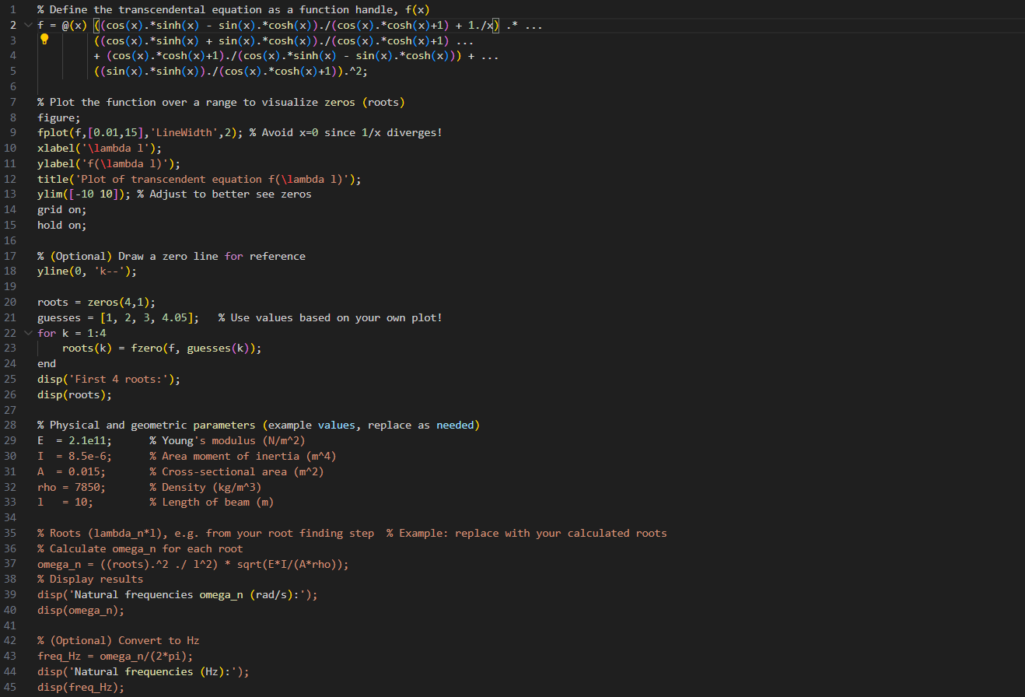
MATLAB Code Snippets

Slide 20
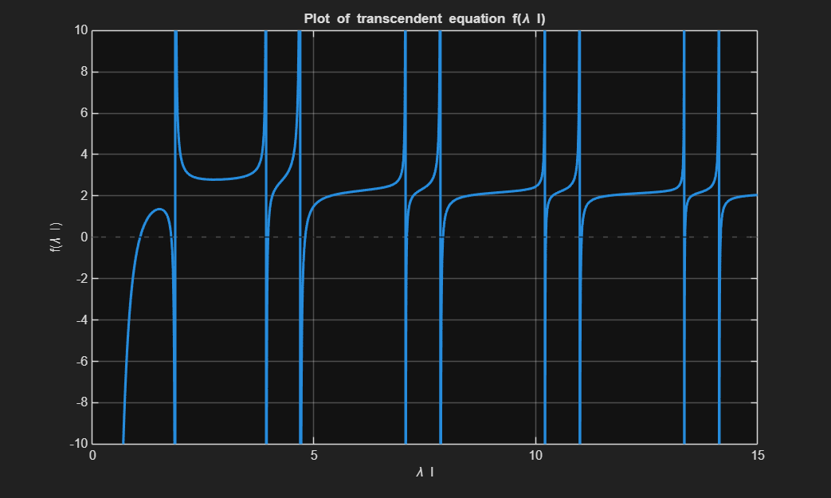
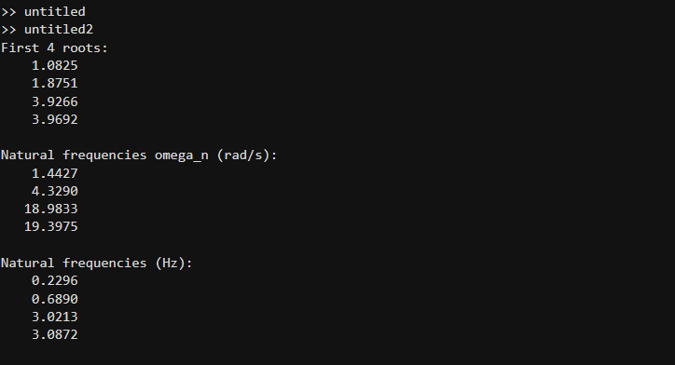
Numerical Results
Guessing the roots of transcendental equation

Slide 21
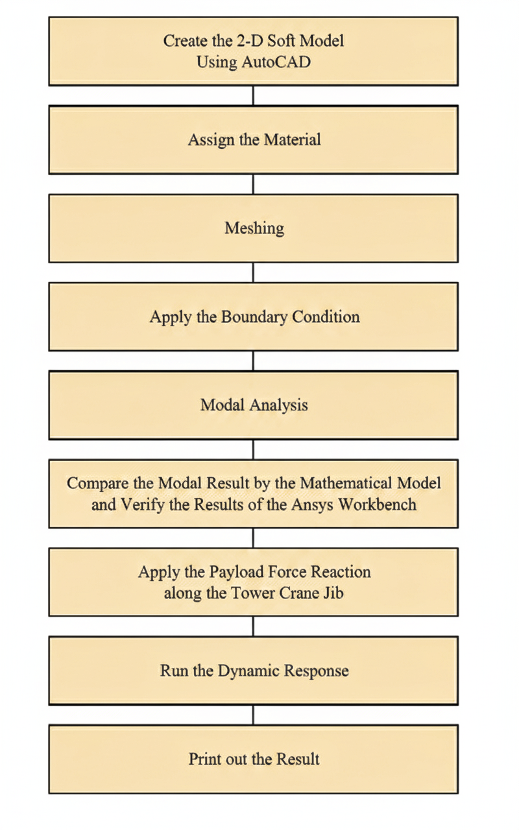
FEA IMPLEMENTATION
FEA (finite element analysis) includes three main steps which are: pre-processing, solution and post-processing phase. The software used for the purpose of this project is ANSYS Mechanical.
Ansys Workbench sequences for the current problem

Slide 22
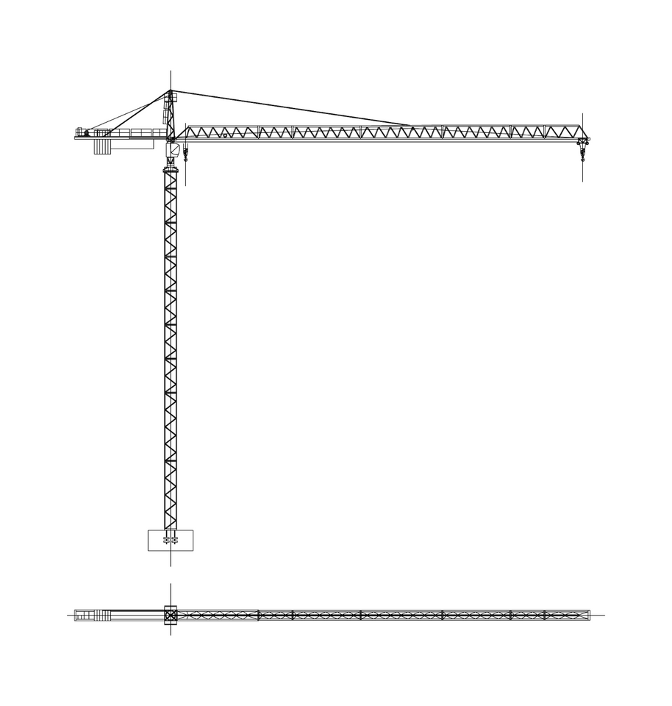
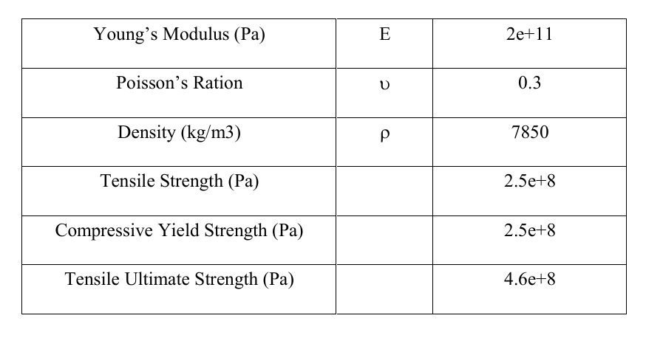
2D Model, Material Selection and Meshing
Fusion360 software was used to create the soft model of the tower crane based on the actual dimensions (LIEBHERR 154 EC H-10)
An essential and complex pre-process step at finite element software is Meshing. Meshing system consist of points (Node) which make a grid (Mesh). At meshing step the geometry model divide into elements. Mesh contains the material and structure properties. Here, we have used automatic meshing.

Slide 23
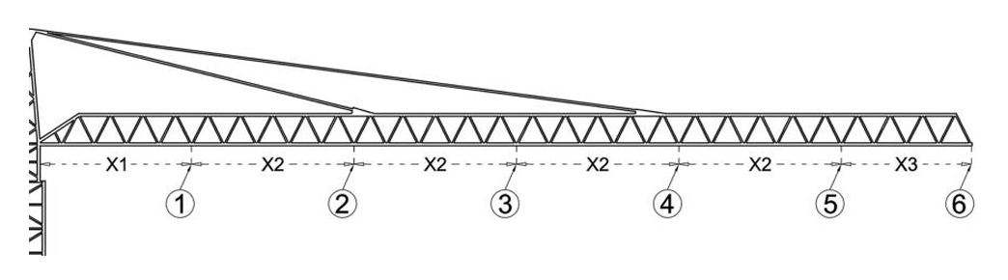
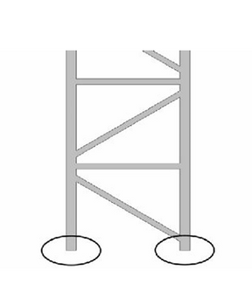
Load and Constraints
Solution
In order to analyze the cranes behavior under the pendulation motion, six points along the jib will be considered.
First four modes of the tower crane are as follows:
Payload Positions along the Jib
Mode | Frequency (Hz)
1st | 0.24
2nd | 0.51
3rd | 2.59
4th | 3.21
Base Constraint

Slide 24
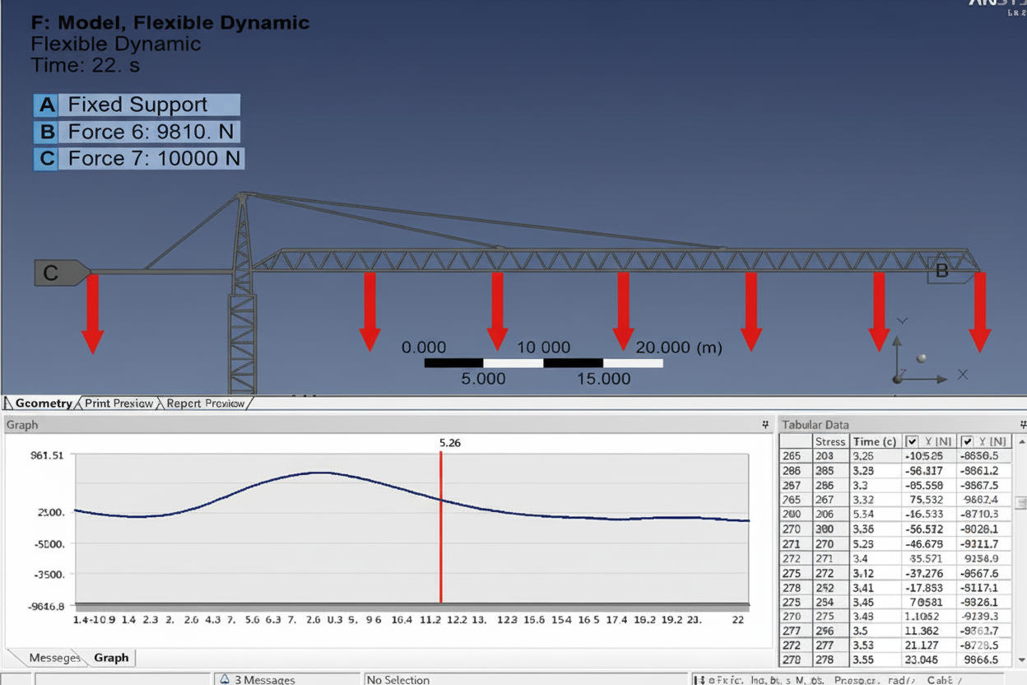
Modal (Flexible Dynamic)
Attaching the Force along the Jib at Workbench

Slide 25
Verification of Results
Mode | FEA ANSYS | Analytical | Error (%)
1st | 0.24 | 0.22 | 9.09
2nd | 0.51 | 0.68 | 25.00
3rd | 2.59 | 3.02 | 14.24
4th | 3.21 | 3.08 | 4.22

Slide 26
Slewing Motion Analysis

Slide 27
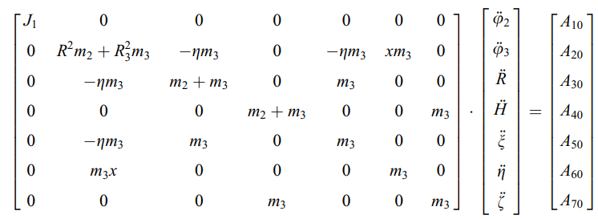
Mathematical Model

Slide 28
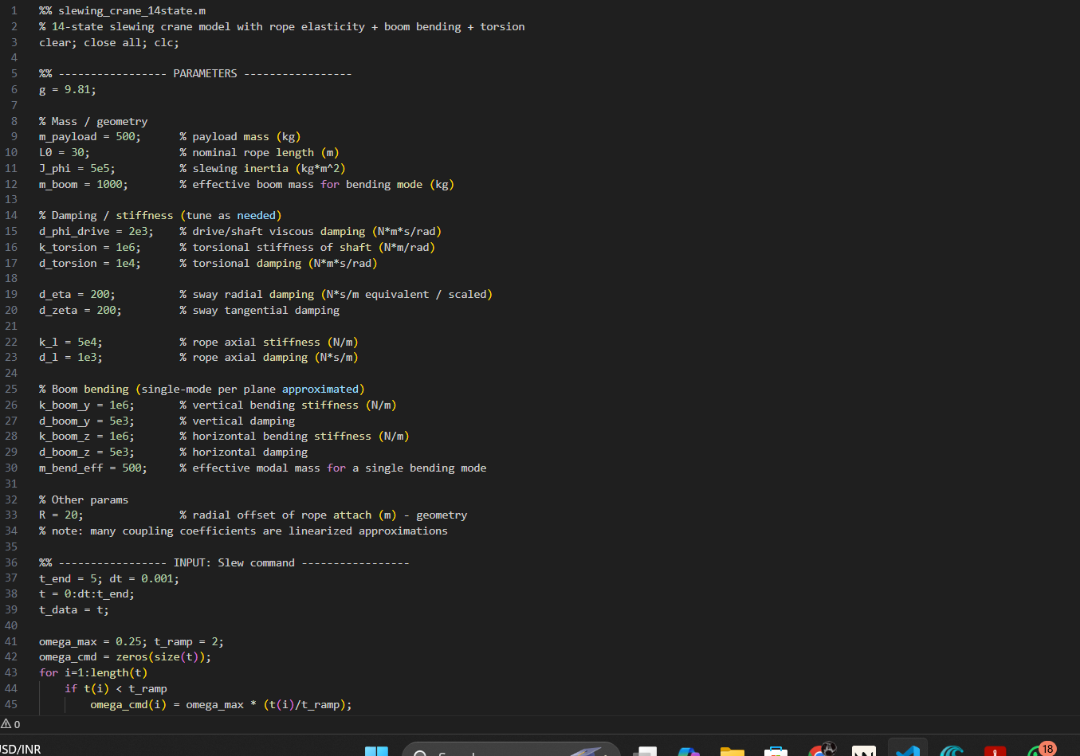
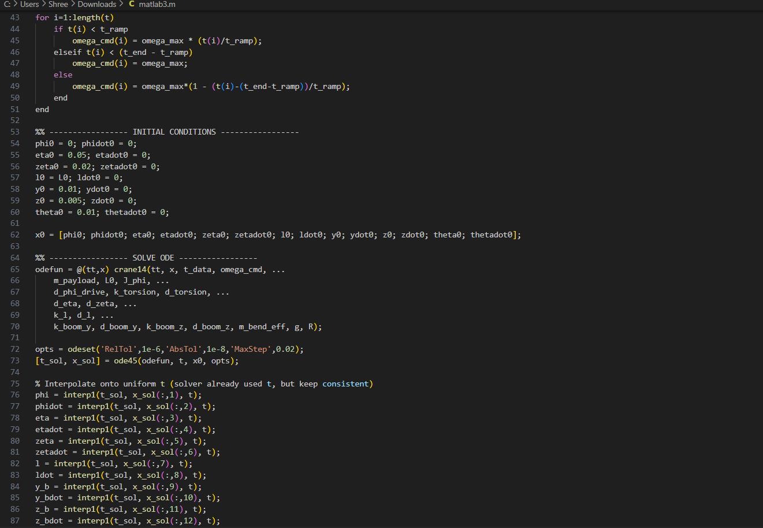
MATLAB Code Snippets

Slide 29
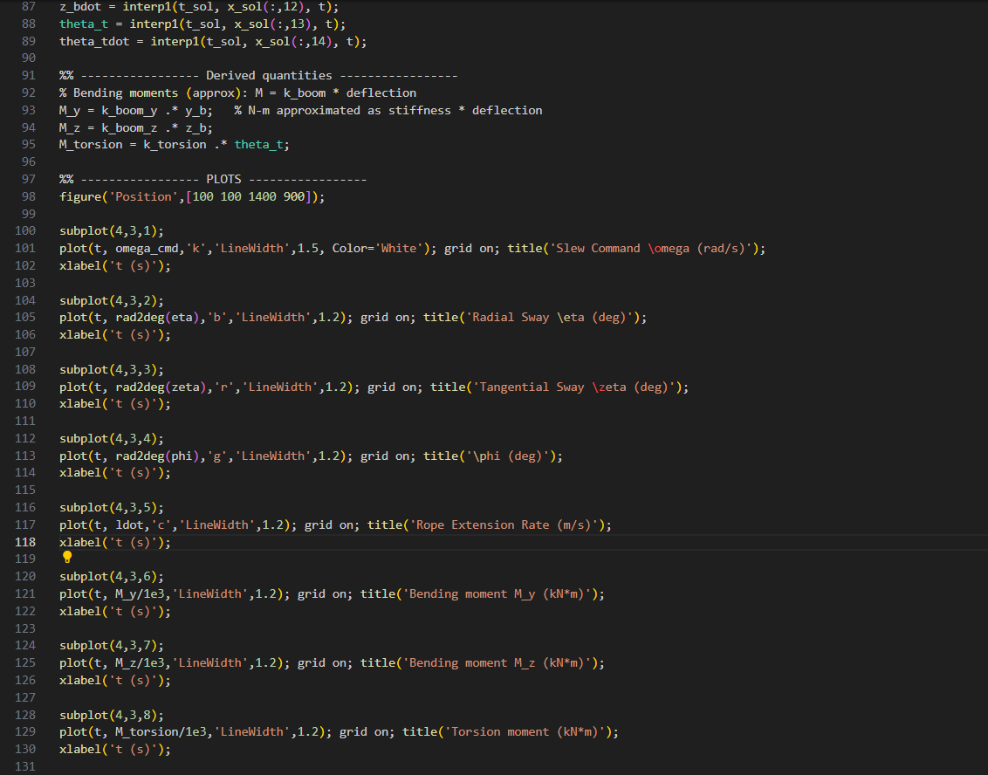
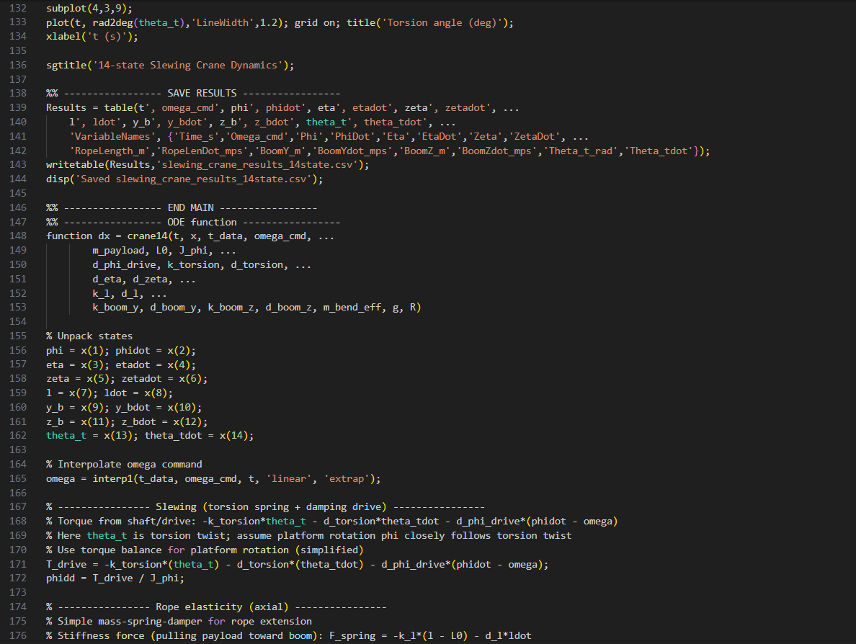
MATLAB Code Snippets

Slide 30
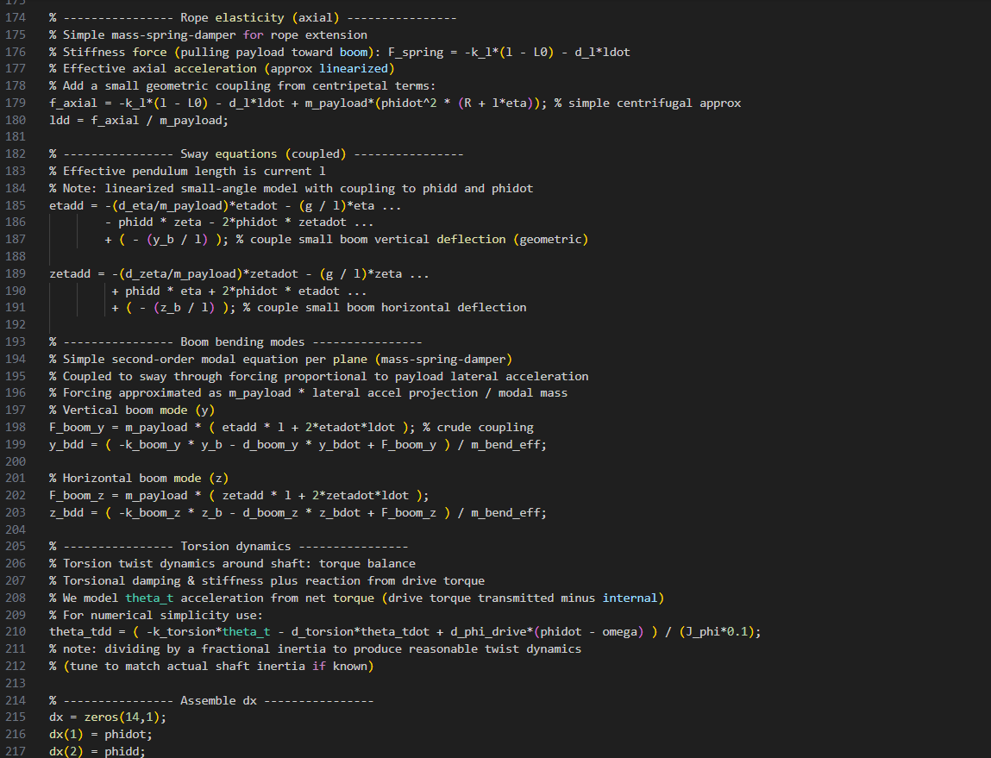
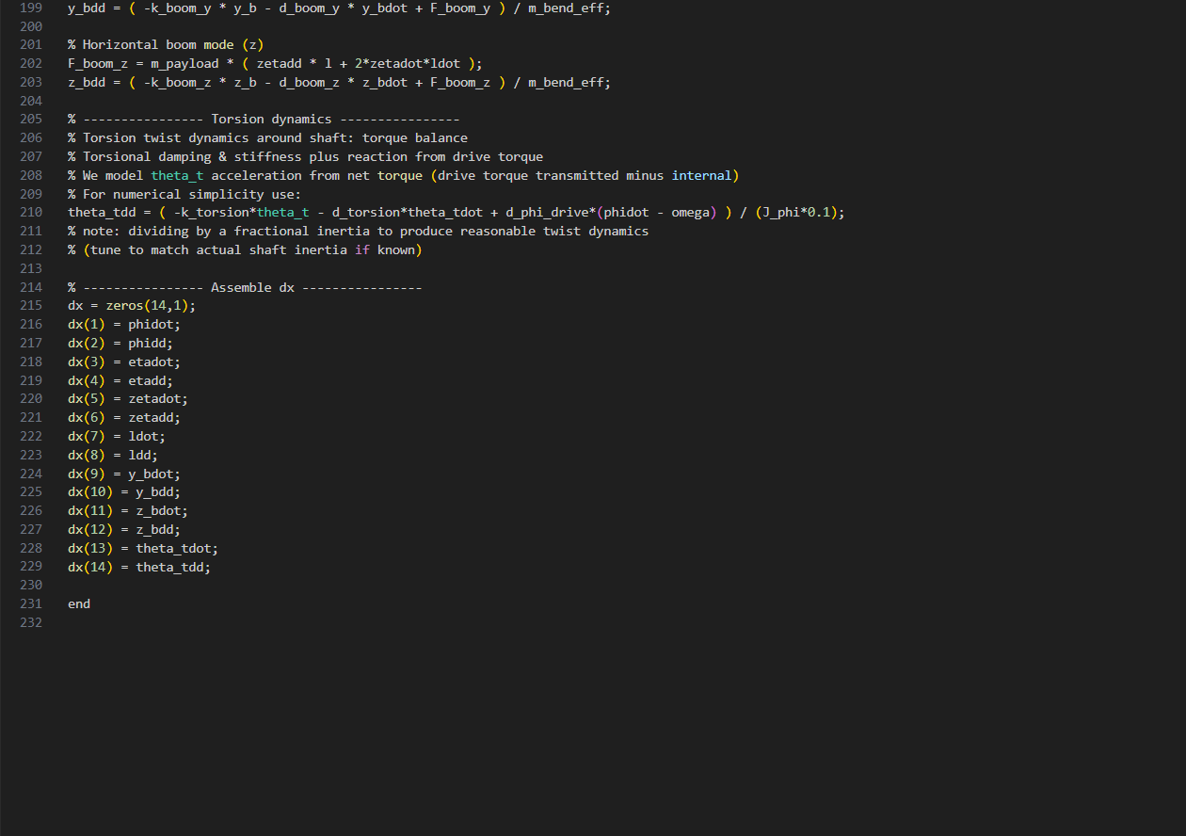
MATLAB Code Snippets

Slide 31
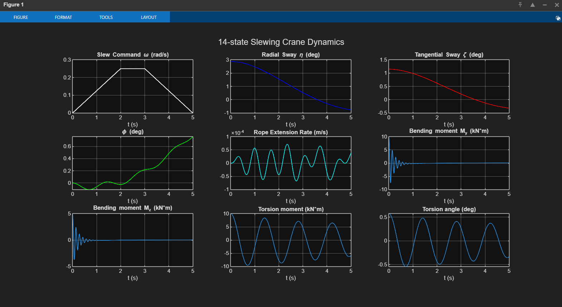
Numerical Result

Slide 32
Failure Scenarios and Limiting Cases
Case 1: Rope Failure
If rope fails:
Payload falls vertically
No swing dynamics—straight vertical drop
Impact on ground/structure below
Mitigation: Multiple independent rope paths; safety hooks; personnel exclusion zone
Case 2: Trolley Loss of Power
If trolley motor fails during motion:
Trolley coasts (gradually decelerates due to friction)
Very rapid deceleration (> 0.5 g) → excessive swing (θ > 20°)
Mitigation: Emergency brakes with controlled deceleration rates
Case 3: Extreme Wind
If wind gust hits suspended load:
Adds lateral force to payload
Can cause large swing angles (> 30°)
Mitigation: Wind speed limits; load distribution; aerodynamic shielding

Slide 33


CONCLUSION
The project successfully developed a rigorous, non-linear dynamic model of the tower crane. The combined Lagrangian and numerical methods provided an accurate prediction of the dynamic loads induced during typical trolley operation. The simulation confirmed high system stability, demonstrating the dynamic loads are well within safety margins (DLF = 1.034) . Future work should prioritise incorporating structural fatigue analysis and developing closed-loop control to mitigate high-swing scenarios.

Slide 34

THANK YOU

Slide 35
Presented By
Arnav Kshirsagar (230103018)
Angelica Das (230103014)
Anmol Sagar (230103015)
Kashvi Agrawal (230103048) [Group Leader]

Slide 36
References
Jerman, B., Podržaj, P., & Kramar, J. (2004). An investigation of slewing-crane dynamics during slewing motion—Development and verification of a mathematical model. International Journal of Mechanical Sciences, 46(6), 843–860.https://www.sciencedirect.com/science/article/pii/S0020740304001092?ref=pdf_download&fr=RR-2&rr=99c704e92bb1d14f#aep-abstract-id18
Abhar, H. N. (Year). Dynamic analysis of the tower crane [Master’s thesis, Universiti Malaya] https://core.ac.uk/download/pdf/268879307.pdf
Ju, F., & Choo, Y. S. (2005). Dynamic analysis of tower cranes. Journal of Engineering Mechanics, 131(1), 88–96. https://ascelibrary.org/doi/full/10.1061/%28ASCE%290733-9399%282005%29131%3A1%2888%29
F. Rauscher and O. Sawodny, "Modeling and Control of Tower Cranes With Elastic Structure," in IEEE Transactions on Control Systems Technology, vol. 29, no. 1, pp. 64-79, Jan. 2021, doi: 10.1109/TCST.2019.2961639. https://ieeexplore.ieee.org/abstract/document/8960557

